Slide 1


Core Values
Brainstem Barn
September 15, 2018

Slide 2
FIRST Core Values
We express the FIRST philosophies of Gracious Professionalism and Coopertition through our Core Values:
Discovery: We explore new skills and ideas.
Innovation: We use creativity and persistence to solve problems.
Impact: We apply what we learn to improve our world.
Inclusion: We respect each other and embrace our differences.
Teamwork: We are stronger when we work together.
Fun: We enjoy and celebrate what we do!

Slide 3
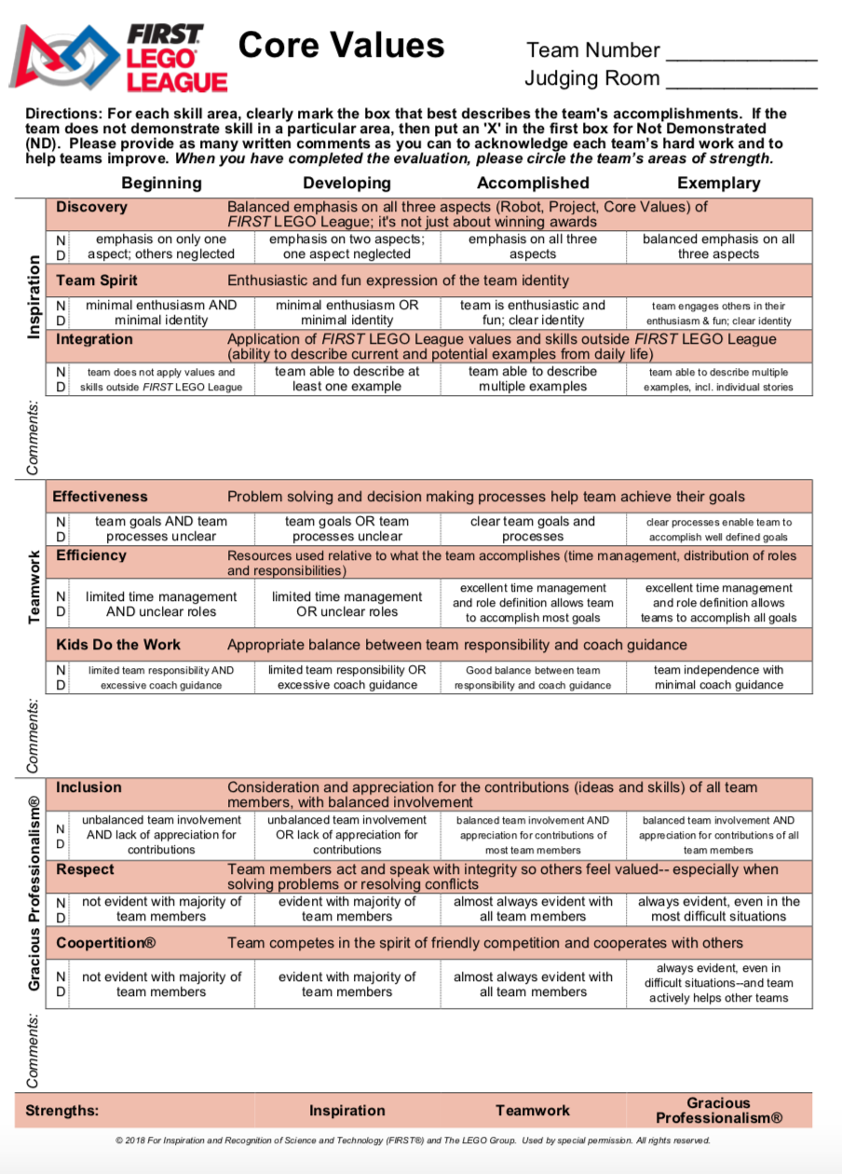
Core Values Rubric
Know the rubric
  Inspiration
    Discovery
    Team Spirit
    Integration
  Teamwork
    Effectiveness
    Efficiency
    Kids Do the Work
  Gracious Professionalism
    Inclusion
    Respect
    Coopertition

Slide 4
FLL Mission Patch- Team Spirit/Identity
THINK ABOUT IT!
What does you team represent?
What is your team known for?
How is your team involved in the community or with other FLL teams?
Does your team have a logo or colors that mean something?
Is your team known for an accessory?
Is there a nickname or cheer that your team has?
Building a team identify focuses on what a
team represents.

Slide 5
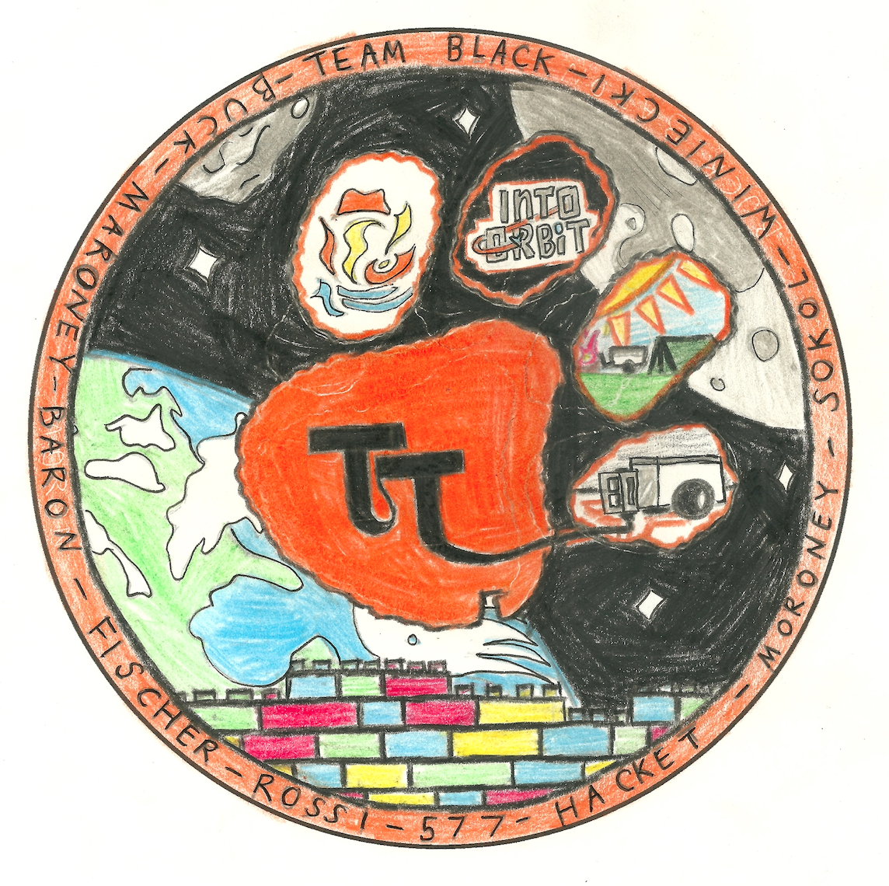
Tiger Techs Mission Patch Example

Slide 6
FLL Mission Patch- Requirements
Mission patches are used to help identify the goal of the mission.
  Every space mission has one or more patches (Apollo, Shuttle, Mars)
Mission Patch Requirements:
Create patch on either of the templates provided (circle or triangle).
Include the last names of the team members, team name, and team number in the design.
A clear team identity is illustrated on the patch.
Illustration is hand-drawn only.
On the back, clearly print team name, number, and location of team.
One patch per team can be submitted.
Please cut out patch upon submission.

Slide 7

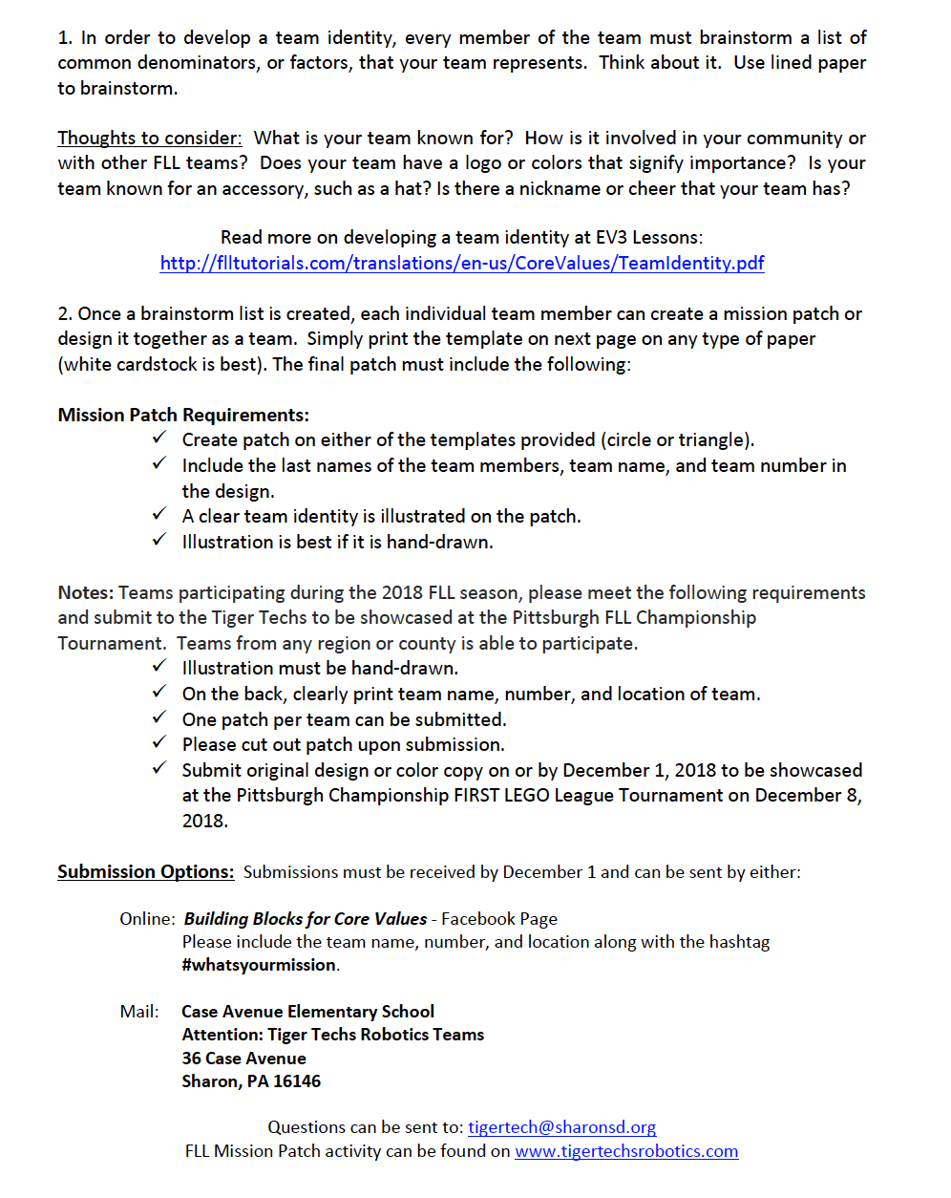
Mission Patch Document

Slide 8
FLL Mission Patch- Submission
Submit original design or color copy on or by December 1, 2018 to be showcased at the Pittsburgh Championship FIRST LEGO League Tournament on December 8, 2018.
Pittsburgh Region/International Teams:
Submissions must be received by December 1st and can be submitted by: 1.) Mail: Case Avenue Elementary School
Atten: Tiger Techs Robotics Teams
36 Case Avenue
Sharon, PA 16146
2. ) Facebook: Building Blocks for Core Values
3. Email: tigertech@sharonsd.org

Slide 9
Contact Info
Most of all, remember to have fun!!
Contact Information
E-mail: tigertech@sharonsd.org
Website: www.tigertechsrobotics.com
Instagram: Tiger Techs Robotics
Facebook: Sharon Robotics
Twitter: Tiger Techs Robotics @FLLTigerTechs

